Slide 1
P
A
R
K
Smart Parking App

Slide 2
CONTENTS
Introduction
Features of application
Development process planing
Benefits of smart parking
Technologies Used in Smart Parking Management Systems
Demonstration for app
Challenges and solutions
Summary

Slide 3
We came up with idea of our project with a “Smart Parking Vehicle System” so we can through it :
.Reduce traffic congestion Improve efficiency
.Save time and effort
.Reduce environmental pollution
.Support electric vehicles
Introduction

Slide 4
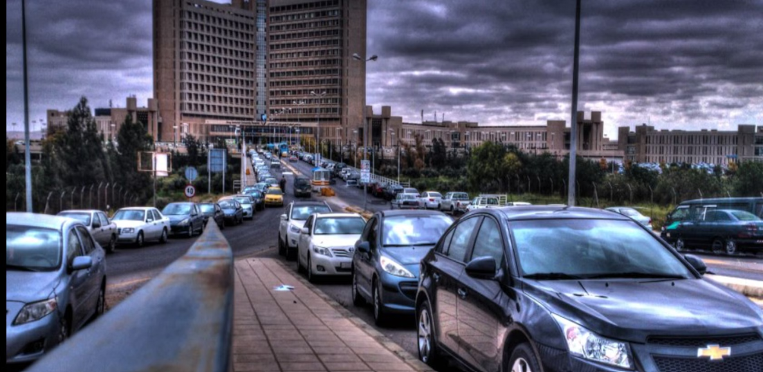
Example: King Abdallah University Hospital Garage
ADD TITLE
According to your need to draw the text box size

Slide 5
Features Of The Application
Easy to use and modern design
Navigation to the suitable available parking spot
Possibility of booking and paying electronically for parking.
Real_time parking space availability
Notifications and alerts about when the parking period ends

Slide 6
Benefits And Solutions
Continuous monitoring slot status and updates it
3
4
Robust backend service
Reduce traffic congestion using traffic signs
2
5
Reducing the time and effort spent finding positions
KEYS
Improve revenue for parking operators through optimizing space management
1
6
Improve the user experience with multiple services

Slide 7
Development Proccess Planning
Development
Planning
Requirement gathering
Setting up the Flutter environment
Implementing core features
Design specifications
Integrating backend services
Design
Testing
Unit testing
UI/UX design using flutter and firebase
Integration testing
User acceptance testing

Slide 8
Flutter
A UI toolkit for developing cross-platform applications, ensuring a consistent user experience across different devices
Camera and Sensor
Technologies
Firebase, and cloud services
Provides backend services like real-time databases, authentication, and cloud functions, enabling real-time data synchronization and secure operations
GPS API and Navigation Tools

Slide 9
challenges Faced
Mapping to specified location
Integrating with existing infrastructure
The effort of designing and developing the application

Slide 10
Demonstration

Slide 11
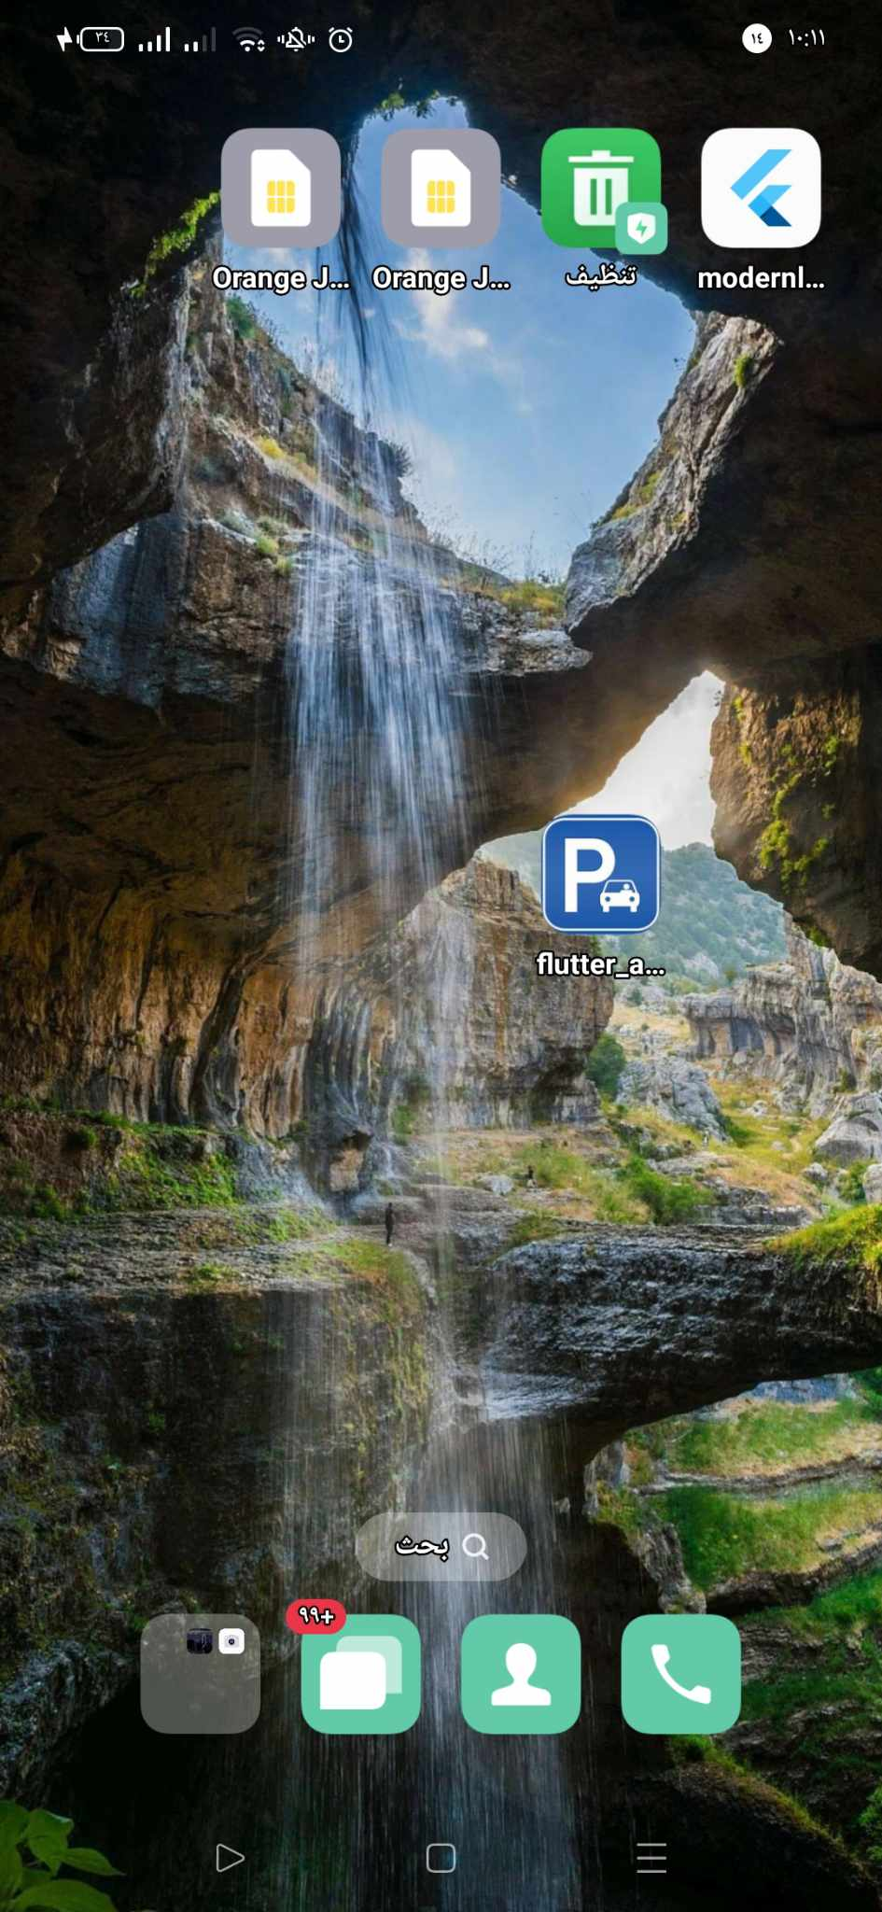
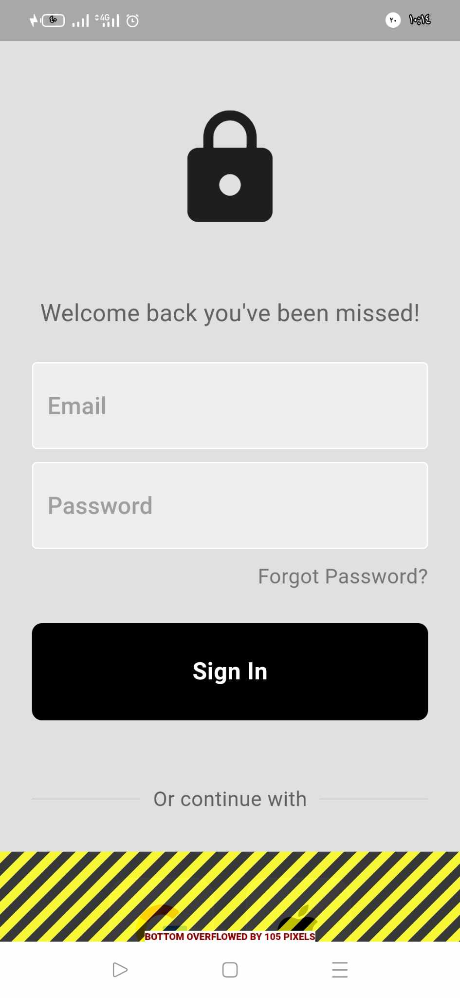
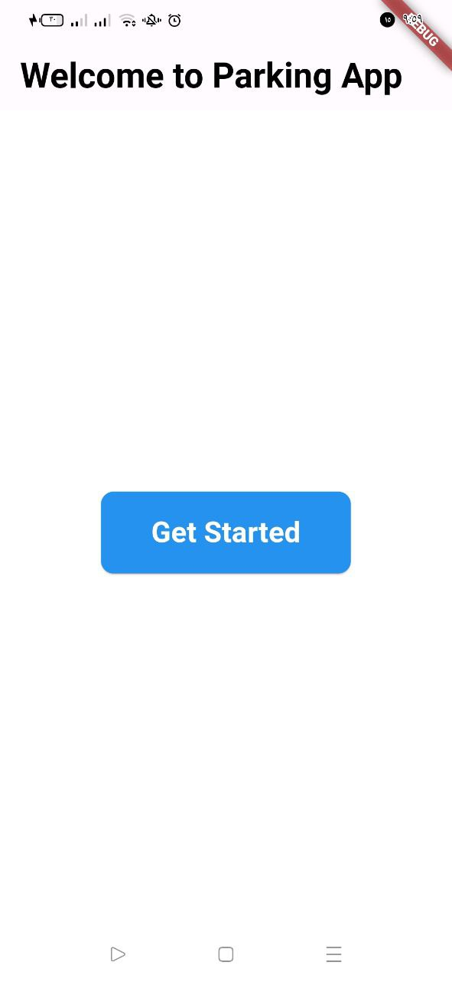

Slide 12
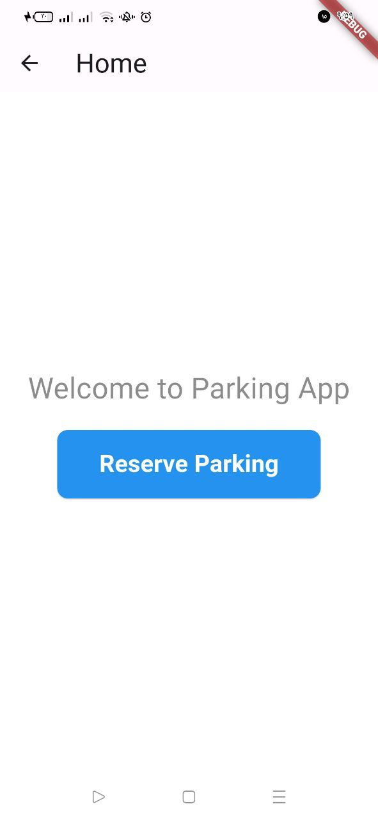
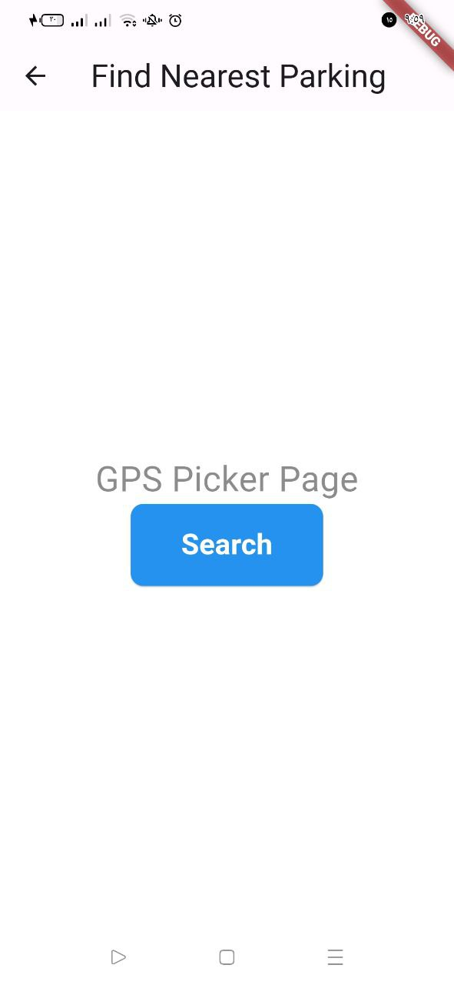
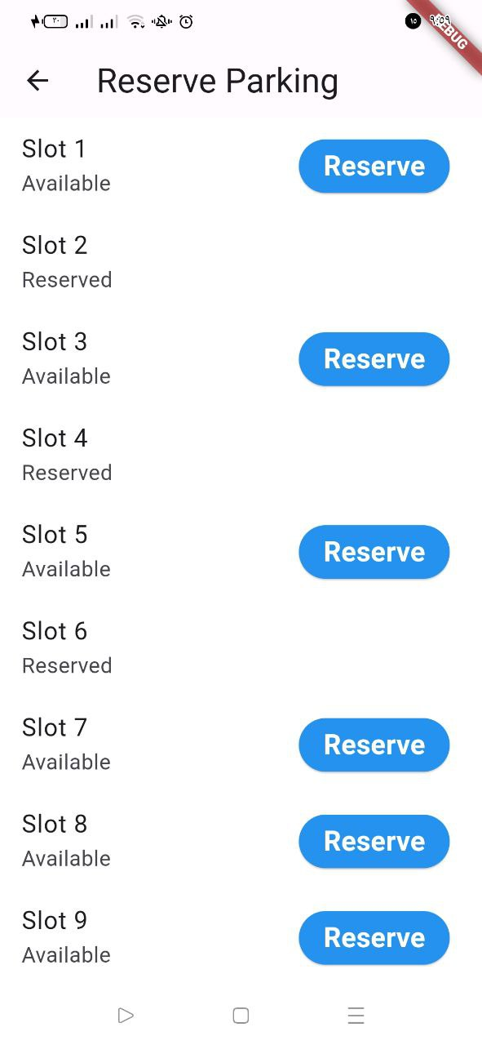

Slide 13
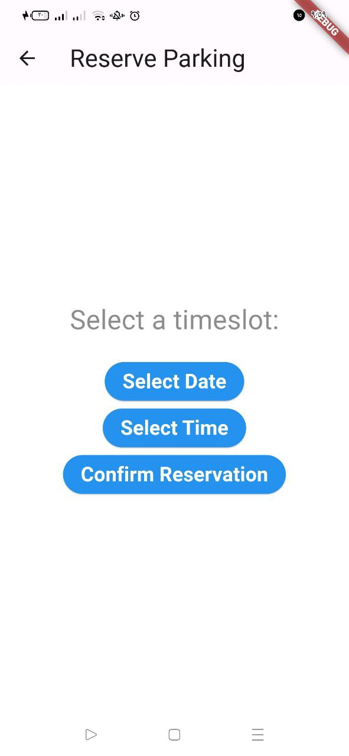
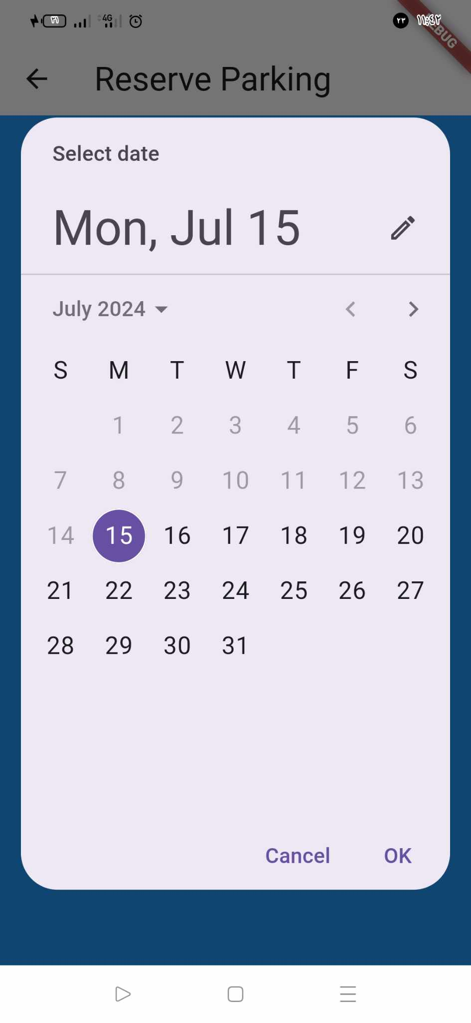
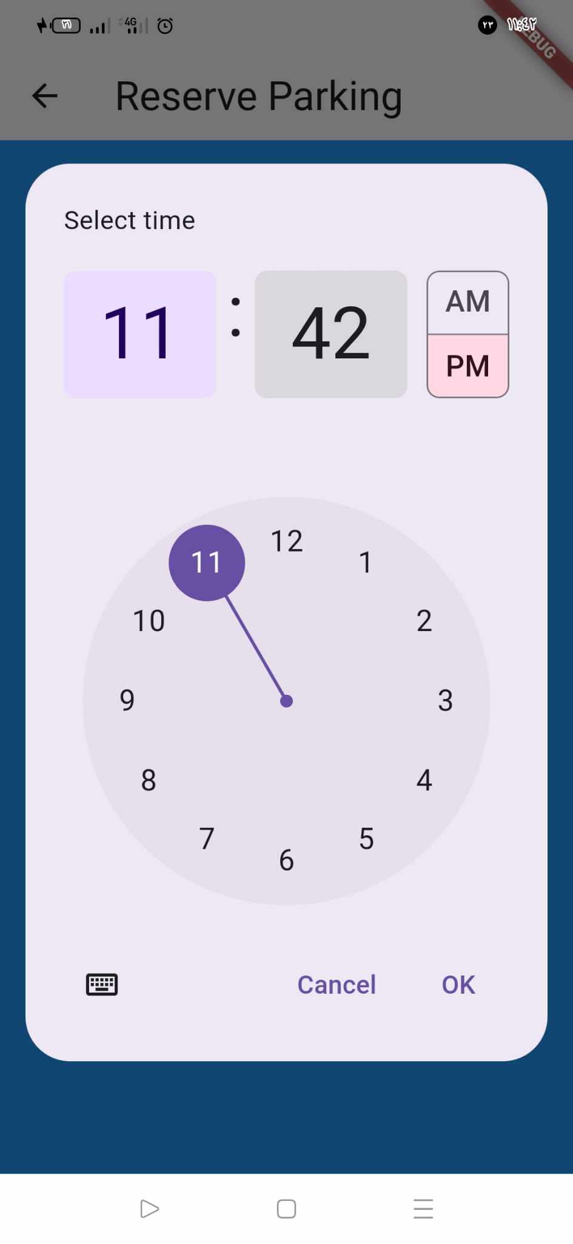

Slide 14
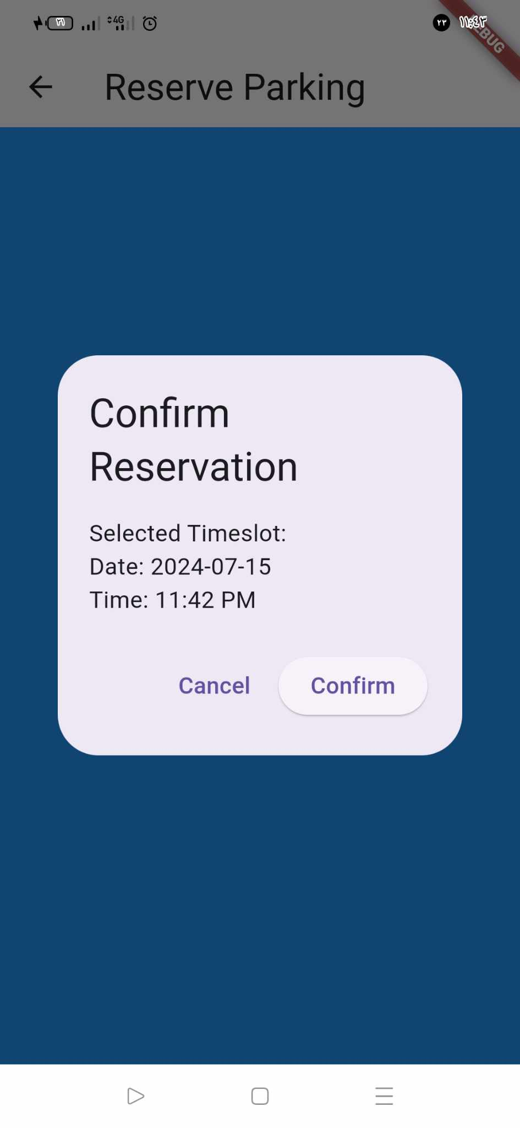
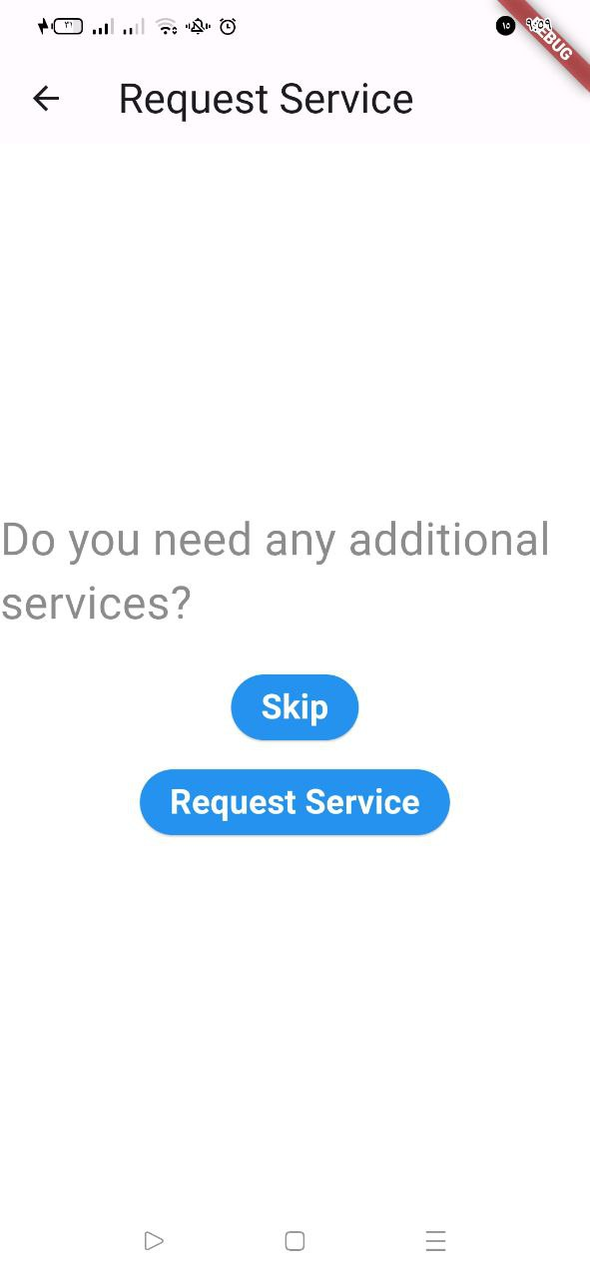
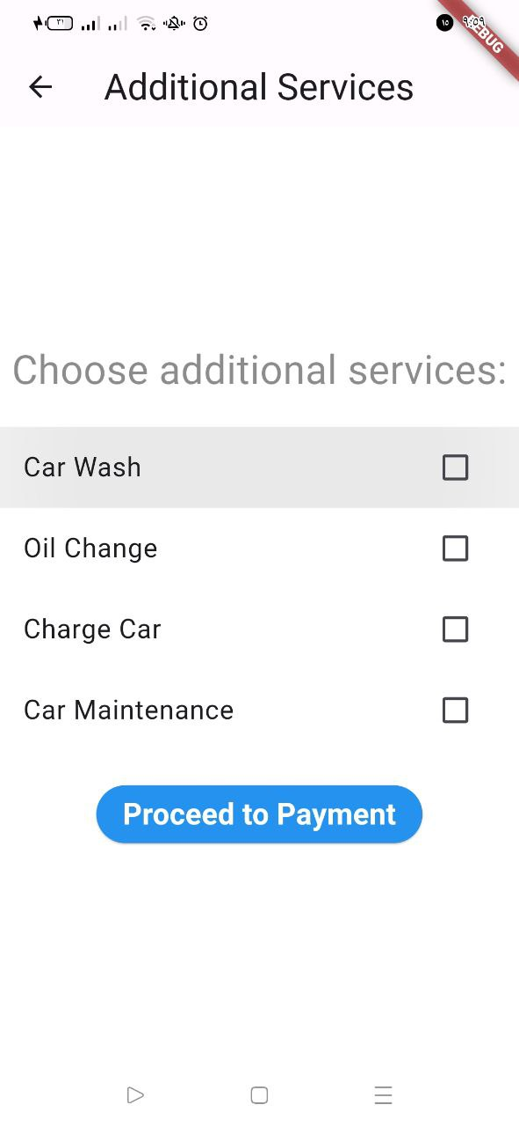

Slide 15
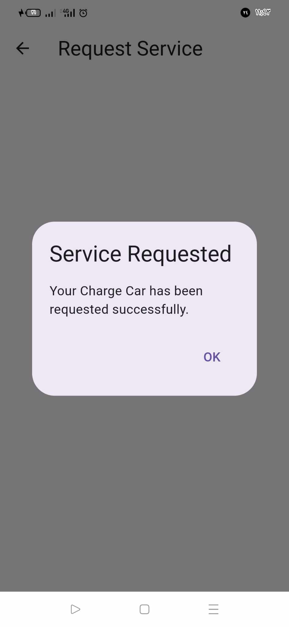

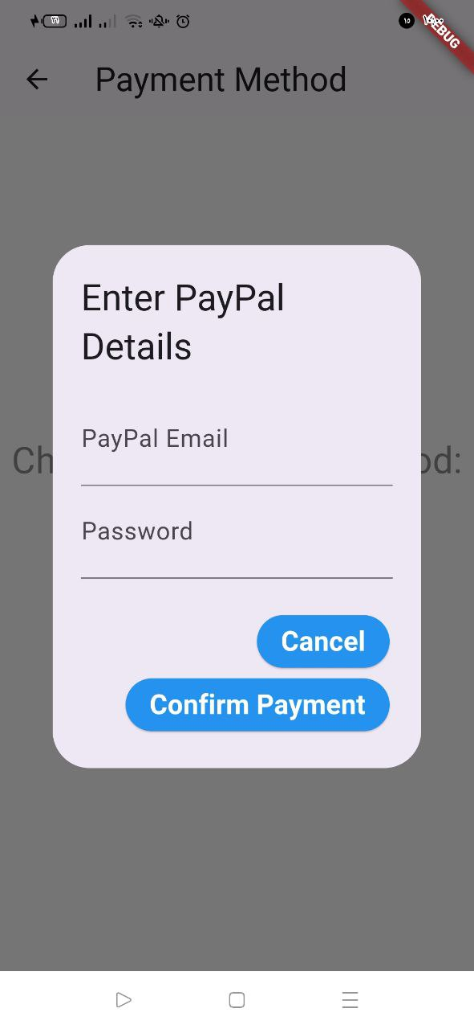
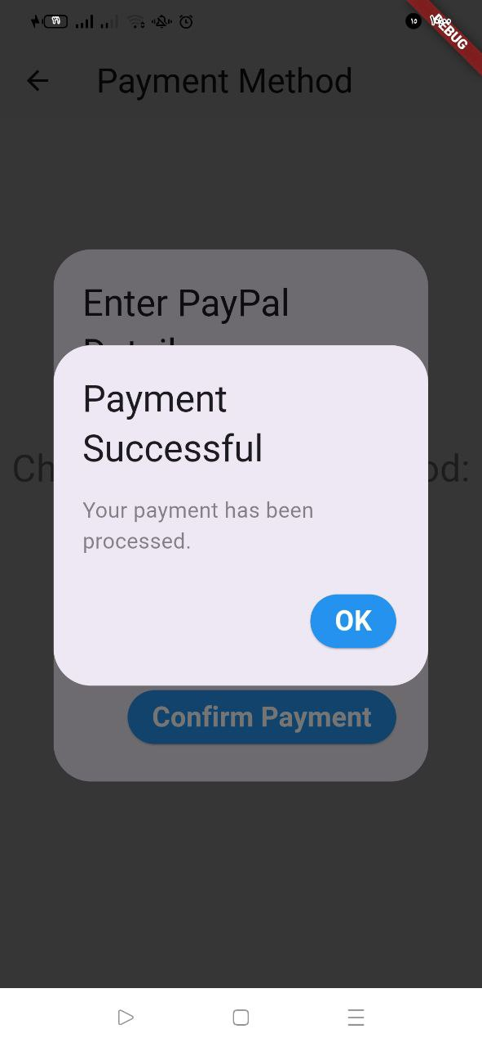

Slide 16
S
U
M
M
A
R
Y
A smart parking system uses technology to make parking easier.
It uses sensors and cameras to find empty parking spots and tells drivers where they are using apps or signs.
This helps reduce traffic and pollution by cutting down on the time cars spend looking for parking.
It also makes paying for parking easier.

Slide 17
THANK YOU
ANY QUESTIONS

